Slide 1

TAKUMI-GShark
Sanghwa Microtech

Slide 2

Agenda
Who is Sangwha
Company history
What we make
What we want
Project milestone

Slide 3

Who is Sanghwa
TSMC Design Center Association
Revenue : 30M$ 2004 , 25M$ 2005
Major customers
Samsung SDI ,
Samsung Electronics
Chips & Media
more than 15 customer

Slide 4
Company history
Beginning Stage
Jan 1997 Established Sanghwa Micro Technology Inc (SMT).
Jul 1997 Registered ASICXpress™ as Trademark
Dec 1997 Made Pro-ASIC Design Center agreement with Zycad (US)
Mar 1998 Made Korea ASIC Design Center agreement with VLSI(US)
Growth Stage
Aug 1999 Made agreement as Artisan Service Net Program
Member of Korea
May 2000 Registered as the official partners related to
ASIC with Samsung Electronics and Samsung SDI
Jun 2000 Opened and got certificate for semiconductor
technology research center
Jun 2001 Made the agreement with LEDA System as
IP Business Partner in Korea
Sep 2002 Made DCA (Design Center Alliance) agreement
with TSMC (Taiwan)
Dec 2003 Listed on KOSDAQ
1997
1999~
2004~
Leaping Stage
Jan 2004 Made ATAP Design Partnership agreement with ARM (UK)
Jul 2005 Moved to the new Office
Mar 2006 Start SoC Level – 1 Business

Slide 5

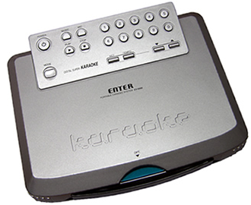
What we make
3D Karaoke SoC
Quantity : 1.5M/years

Slide 6
What we want
3D IP License
  G-Shark 2 or G-Shark Turbo
S/W API
  OpenGL ES 1.1 Compatible
  Target O/S : WinCE and Linux
Flash Animation Accelerator
4. Dedicated engineering support
5. Competitive low price

Slide 7
Project Milestone
3D IP Survey
  . End of July 06
License
. End of Aug 06
FPGA Test
. End of Oct 06
Mass Product
. Will be April 07

Slide 8

Discussion

Slide 9

Contact point
Sales
YS Sohn.
ysson@shmt.co.kr
Technical
Kevin Im
jylim@shmt.co.kr
82-18-225-2269

